Slide 2
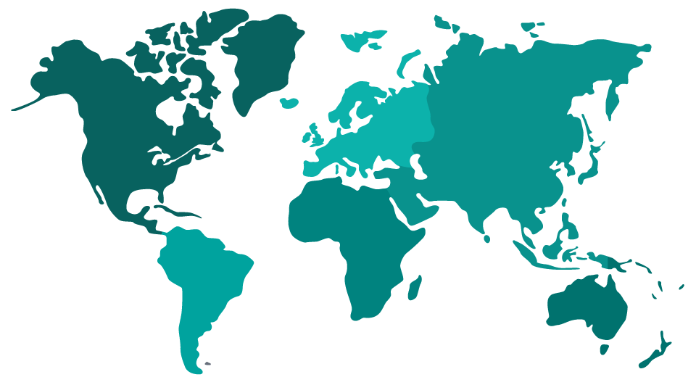
Locations
Stockholm.
Amsterdam.
Washington DC.
Delhi.
Kathmandu.
Bamako.
Ouagadougou.
Bogotá.
Kampala.
Nairobi.
Denpasar.
Perth.

Slide 3
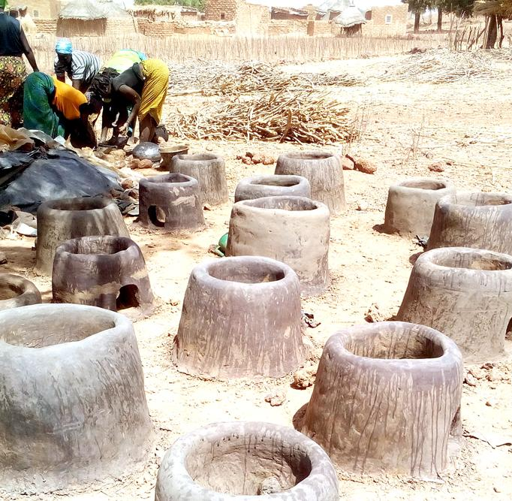
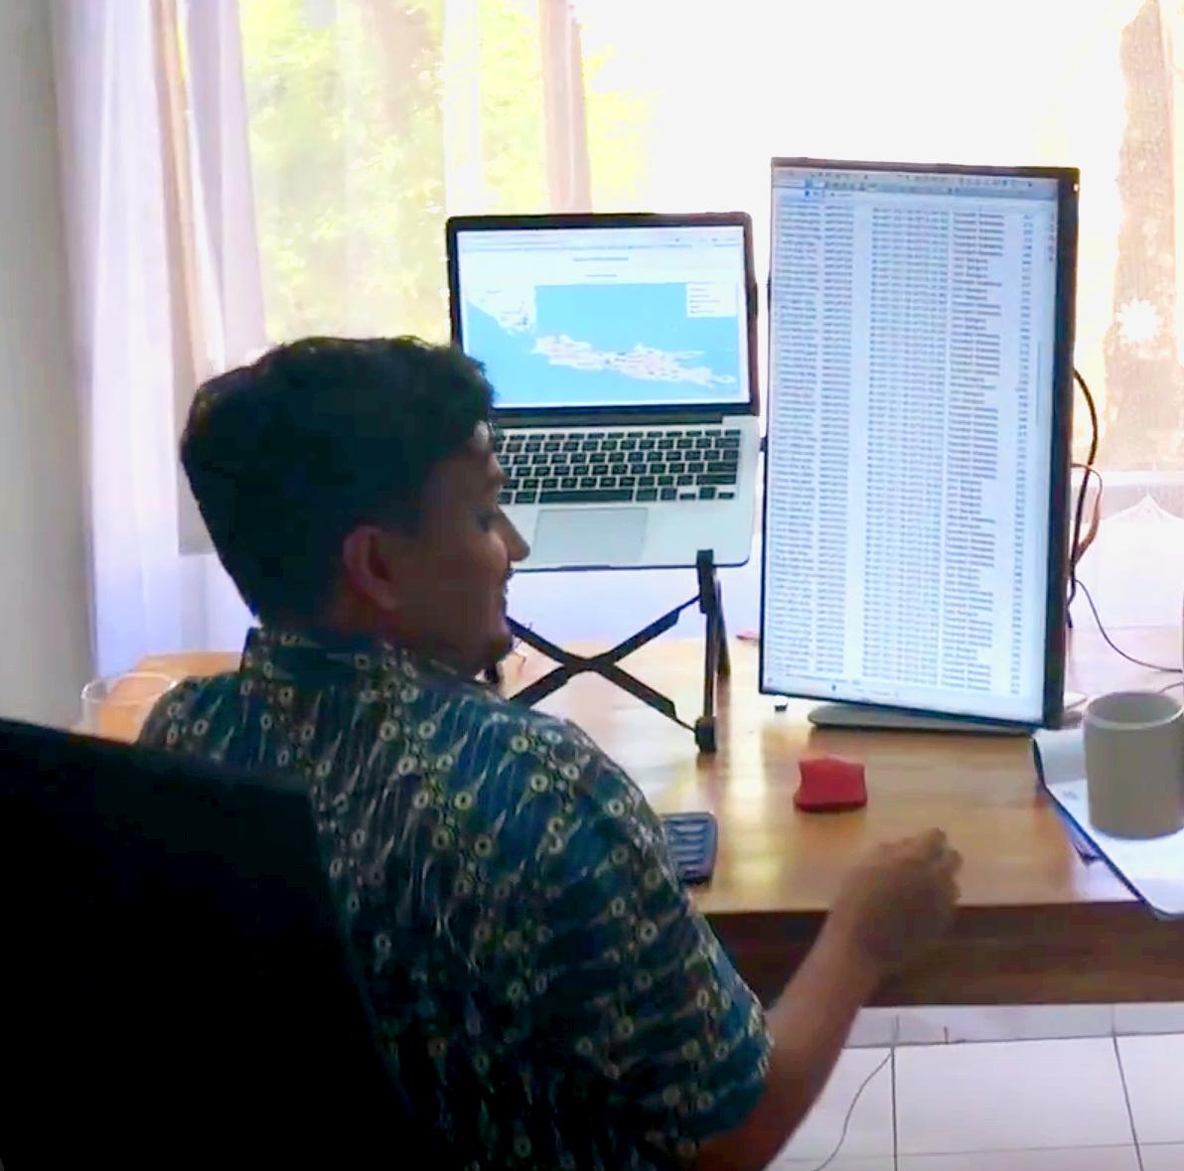
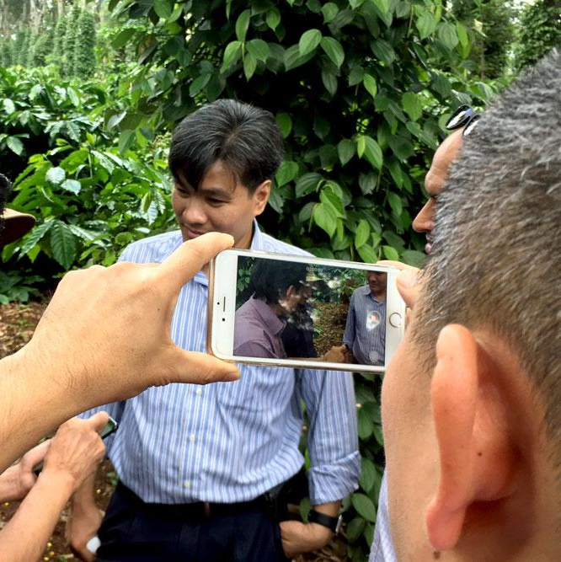
The data journey
Design
Share insights with the relevant people, generate dialogue, encourage decision making and continuously improve your work.
Gain clarity on the context of your programme, the problem you are trying to solve, the data you need, and the roles and responsibilities of each partner.
Act
Capture
Capture reliable and high
quality data from the start. Monitor your data collection to ensure accuracy and track progress.
Extract the insights that matter. Clean, analyse and visualise your data and turn it into valuable information and knowledge.
Understand
Notes:
Needs a title?

Slide 5
Akvo Flow and Lumen
Akvo Flow https://vimeo.com/129656646
Akvo Lumen https://vimeo.com/212001735

Slide 6
Data collection and use
Use (in group)
Use (for target audience)
Collect data
Analyse &
visualise

Slide 7
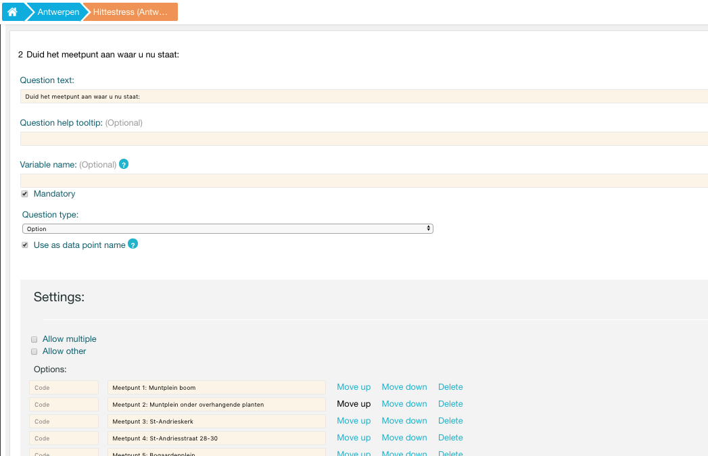

Slide 8
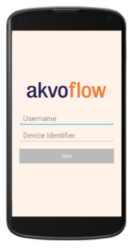

Slide 10
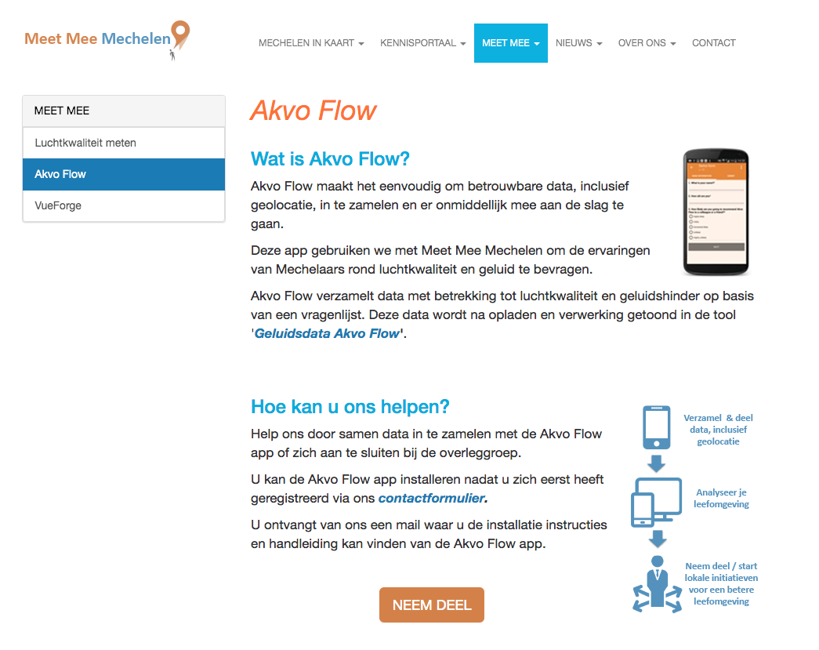

Slide 11
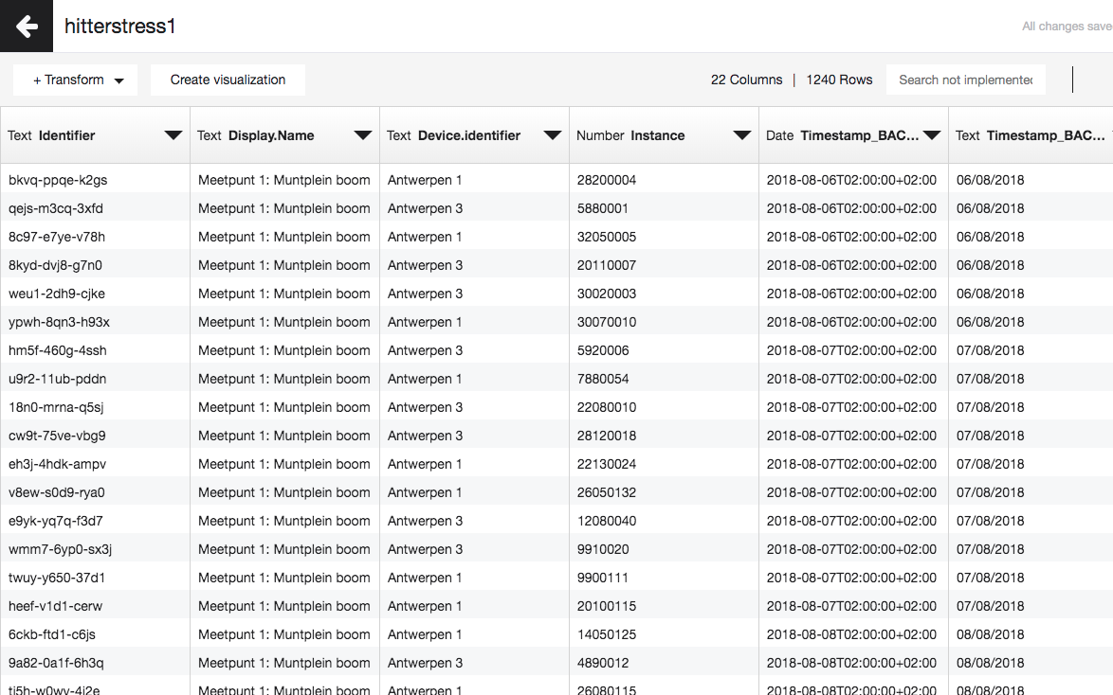

Slide 12
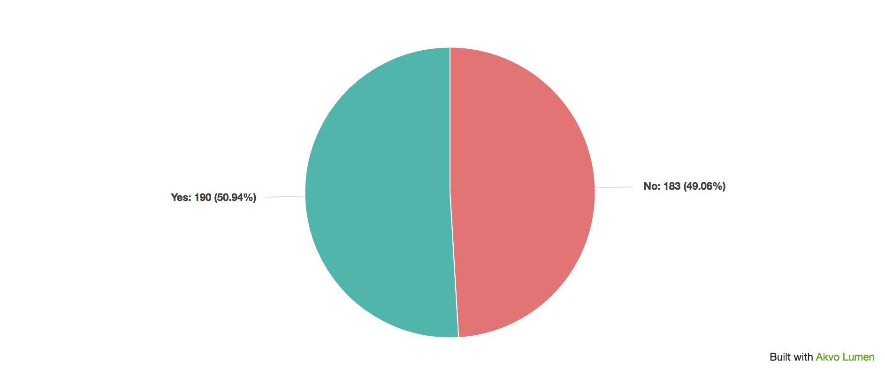
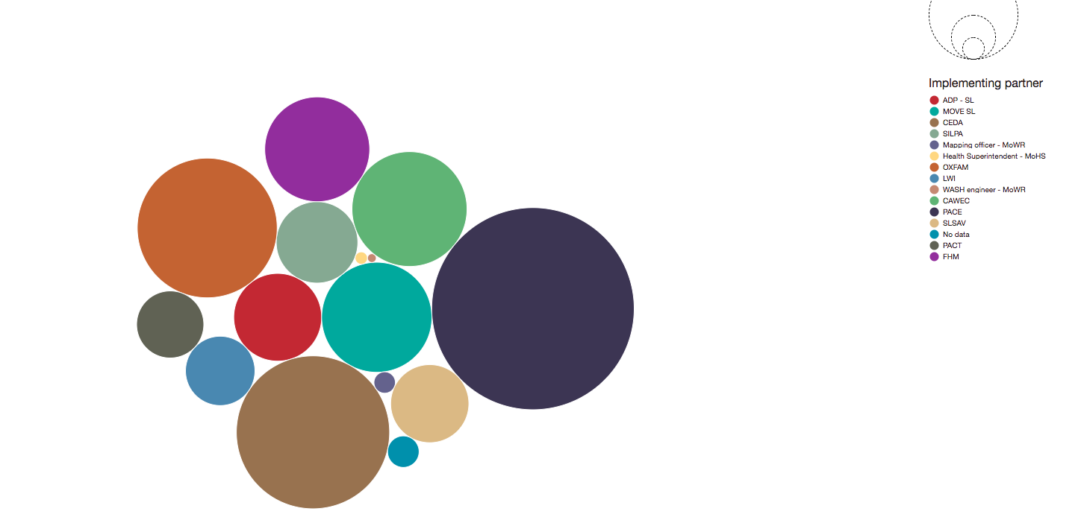
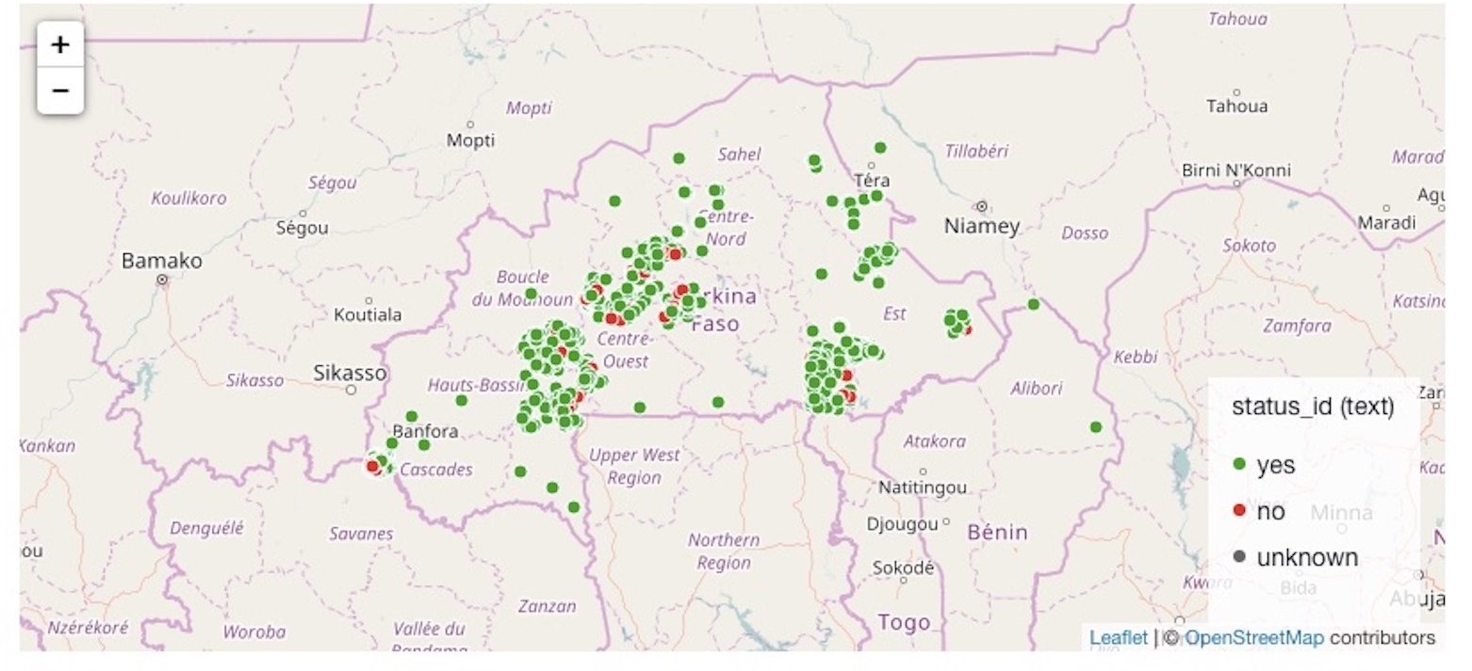
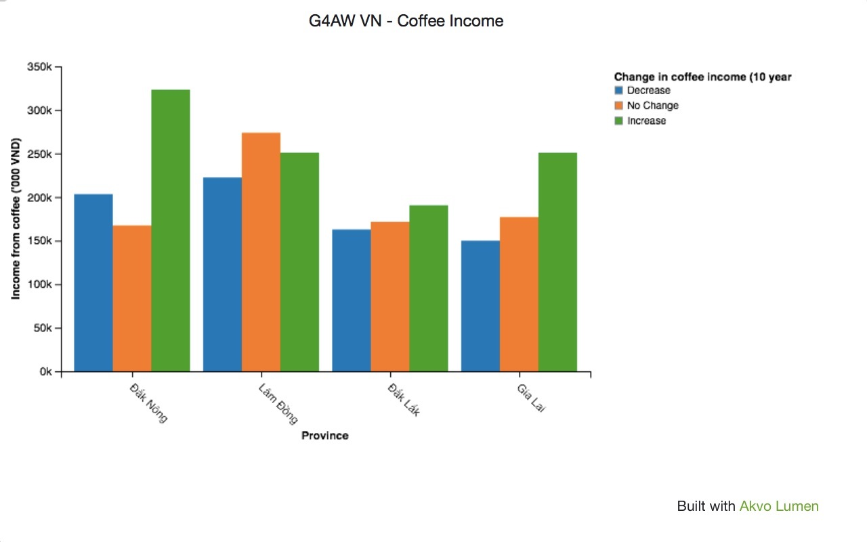
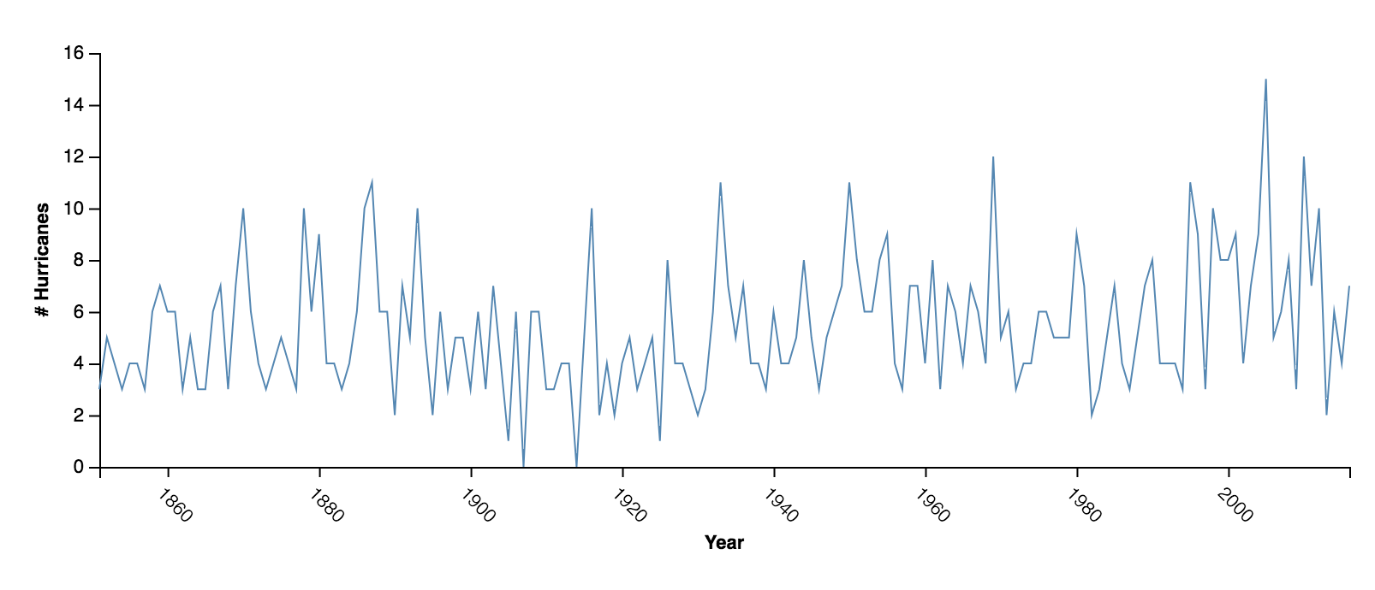
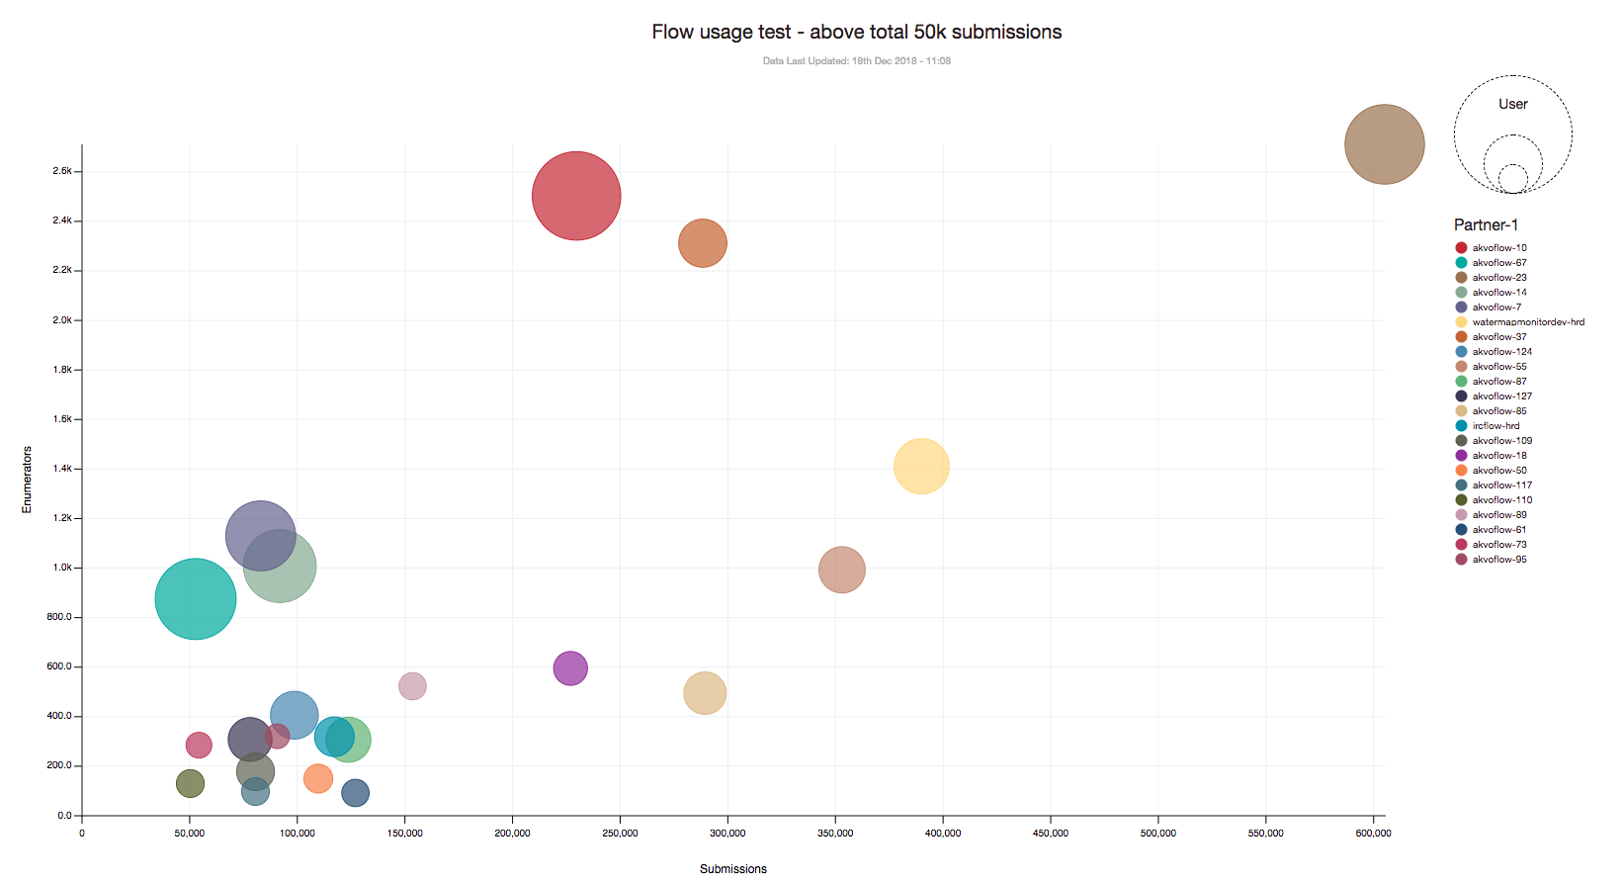

Slide 13
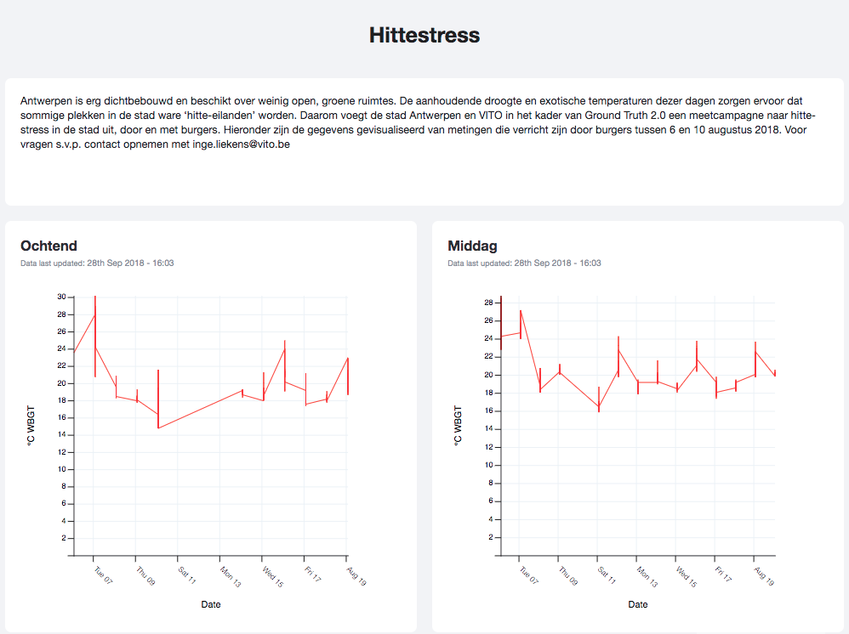

Slide 14
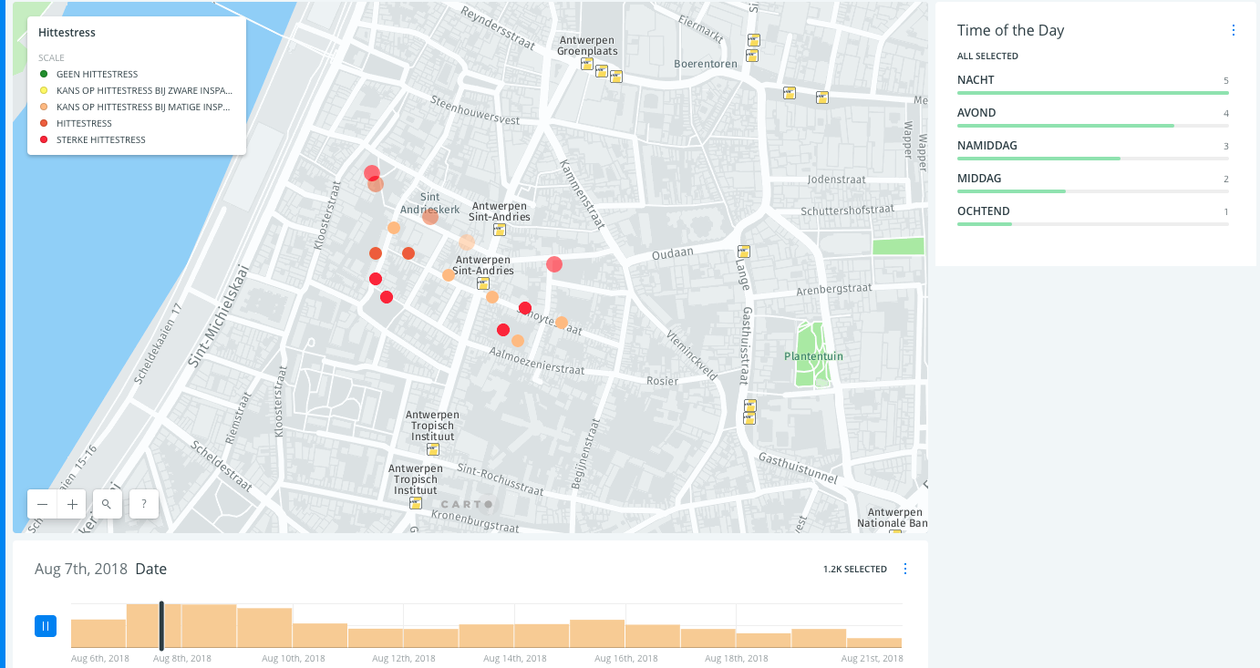
https://akvo.carto.com/builder/d52957c3-0605-42e1-90da-db6670b88acd/embed

Slide 15
